Slide 1

SRM INSTITUTE OF SCIENCE AND TECHNOLOGY
TRICHY CAMPUS
DEPARTMENT OF ELECTRONICS AND COMMUNICATION ENGINEERING

Slide 2
TOPIC
WEARABLE OSCILLOSCOPE
E G PRADEEP
M P NITHEESWARAN
M S SAISANKEET

Slide 3
INTRODUCTION
Oscilloscopes are used to display changes in electrical signals over a period of time in terms of X and Y axis, displayed on a calibrated scale. We here develop a smart watch with built in oscilloscope that takes electronics, troubleshooting and development to the next level. The system is basically a wearable device that puts the oscilloscope on your wrist for use as and wherever you desire.
For this system we make use a battery powered device with battery charging and monitoring circuitry. This checks for battery level and also alerts for charging if battery low and auto cut off battery protection from overcharging. We here develop a Low frequency oscilloscope that covers frequency range upto 20 Khz DC. Also it can deliver a maximum sampling rate of 50000 samples/sec. This will allow for 60 pixels placed on y axis depending on the analogue signal.
The circuitry utilizes a single operation amp IC that is LM358 which incorporates two operation amps inside one single chip. As the info sign will be AC and we don’t have split rail development, there are two operation amps (from a single Op-Amp 8 pin package) used to make the sign ac coupled. Both the operation amp is taken care of with a reference voltage that is utilized to balance the sign and utilizing simple data sources it is plotted on the extension chart.
The offset can be changed utilizing the potentiometer (which is having 100K opposition). Both the operation amp are set with a similar negative criticism with a x5 gain setting. Other than this the OLED is connected over the A4 and A5 is the I2C SCL and SDA pin with a 4.7K draw up resistor. It could work with a basic USB connector. The buttons are utilized to set the parameters of the Oscilloscope.
We hereby use an Arduino Nano board to monitor and analyze these signals and display on the OLED display. A small battery is used to power the entire operation. This entire setup is mounted on a wrist band so as to make it portable and easy to use.

Slide 4
COMPONENTS REQUIRED
ARDUINO
OLED DISPLAY
BATTERY
BATTERY CONTROLLER
PUSH BUTTONS
LED’s
PCB BOARD
RESISTOR
CAPACITOR
TRANSISTORS

Slide 5
PROPOSED SYSTEM
For this system we make use a battery powered device with battery charging and monitoring circuitry. This checks for battery level and also alerts for charging if battery low and auto cut off battery protection from overcharging. We here develop a Low frequency oscilloscope that covers frequency range upto 20 Khz DC. Also it can deliver a maximum sampling rate of 50000 samples/sec. This will allow for 60 pixels placed on y axis depending on the analogue signal.

Slide 6
HARDWARE AND SOFTWARE REQUIRED
Arduino IDE (Open Source Software)
Soldering kit
Soldering metal wire

Slide 7
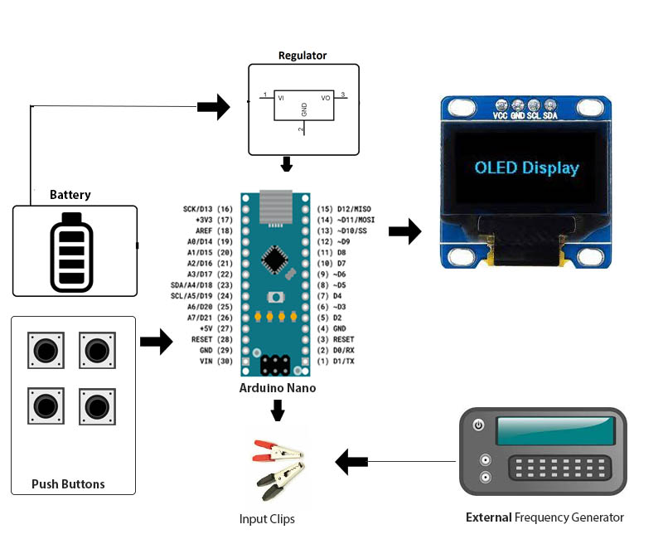
COMPONENTS FIGURE

Slide 8
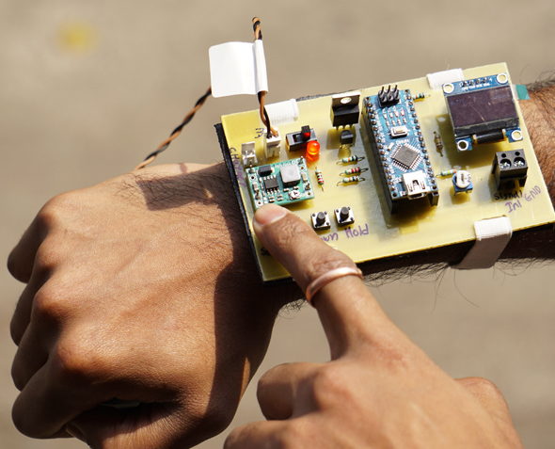
OUTPUT

